Slide 1
ATAI
Advanced Techniqueof Artificial Intelligence
ATAI
ChongqingUniversity _{AdvancedTechniqueof}
of Technology Artificial Intelligence
Chongqing University of
Technology
Chongqing University ^{ATAI}
_{of Technology} Advanced Techniqueof
Artificial Intelligence
Chongqing University of Technology
Chongqing University of Technology
GraphPro: Graph Pre-training and Prompt Learning
for Recommendation
—— WWW 2024
Code: https://github.com/HKUDS/GraphPro
2024.6.6 •ChongQing
Reported by Ling Tan
1

Slide 2
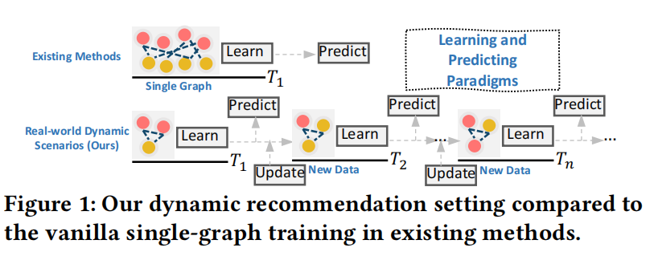
ATAI
AdvancedTechniqueof
Artificial Intelligence
ATAI
ChongqingUniversity _{AdvancedTechniqueof}
of Technology Artificial Intelligence
ChongqingUniversity of Technology
Motivation
（1）These methods are primarily designed for single-graph training and evaluation, resulting in a decline in recommendation dynamics and widening the gap between offline and online performance.
（2）Additionally, the arrival of new data often brings distribution shifts,further complicating accurate recommendations for graph-based models that do not incorporate relevant contextual information for the newly arrived data.

Slide 3
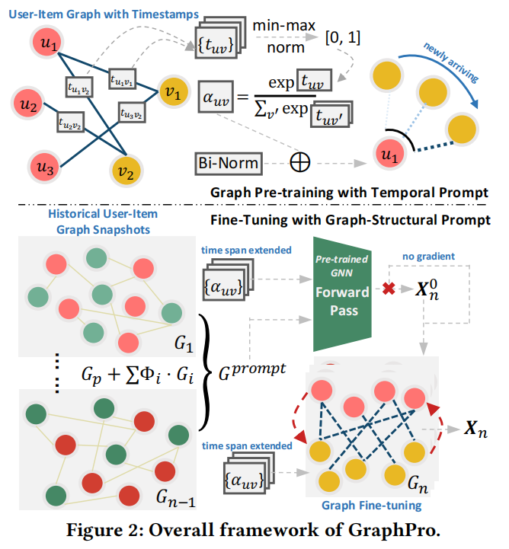
ChongqingUniversity of Technology
ATAI
AdvancedTechniqueof
Artificial Intelligence
ATAI
ChongqingUniversity _{AdvancedTechniqueof}
of Technology Artificial Intelligence
Overview

Slide 4
ChongqingUniversity of Technology
ATAI
AdvancedTechniqueof
Artificial Intelligence
ATAI
ChongqingUniversity _{AdvancedTechniqueof}
of Technology Artificial Intelligence
Method
PRELIMINARIES

Slide 5
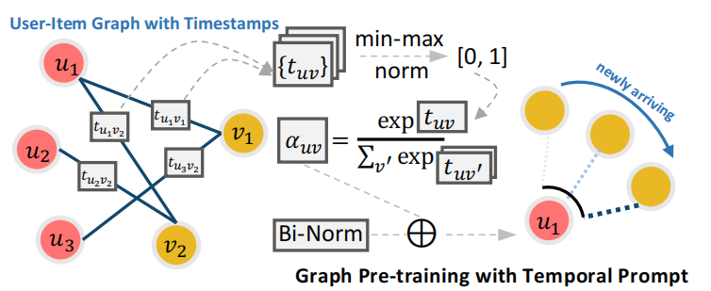
ChongqingUniversity of Technology
ATAI
AdvancedTechniqueof
Artificial Intelligence
ATAI
ChongqingUniversity _{AdvancedTechniqueof}
of Technology Artificial Intelligence
Method

Slide 6
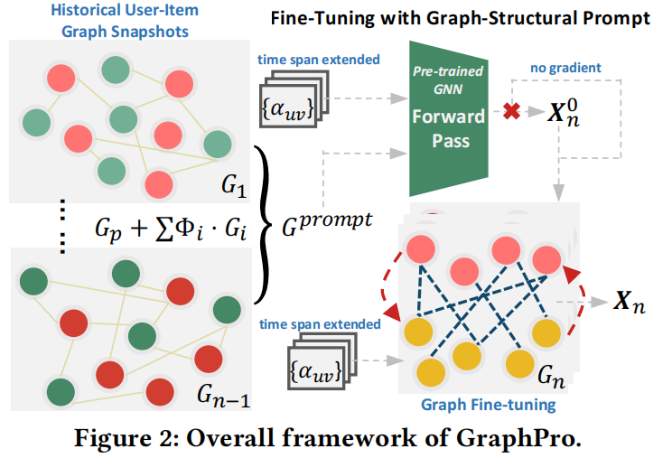
ChongqingUniversity of Technology
ATAI
AdvancedTechniqueof
Artificial Intelligence
ATAI
ChongqingUniversity _{AdvancedTechniqueof}
of Technology Artificial Intelligence
Method

Slide 7
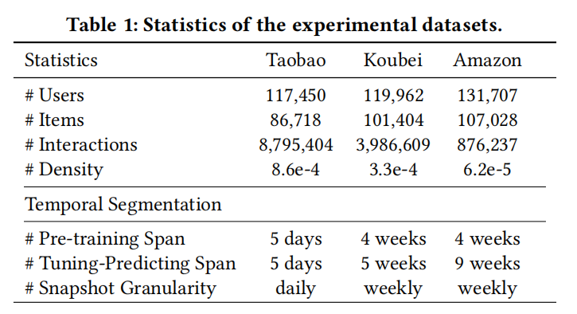
ATAI
AdvancedTechniqueof
Artificial Intelligence
ATAI
ChongqingUniversity _{AdvancedTechniqueof}
of Technology Artificial Intelligence
ChongqingUniversity of Technology
Experiments

Slide 8
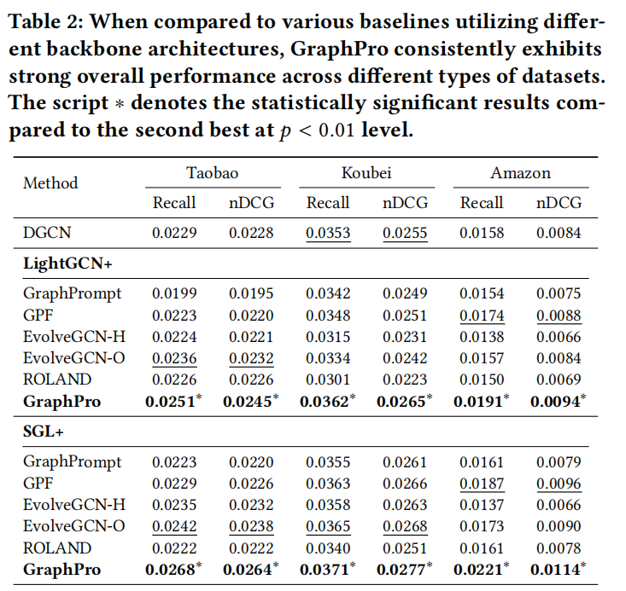
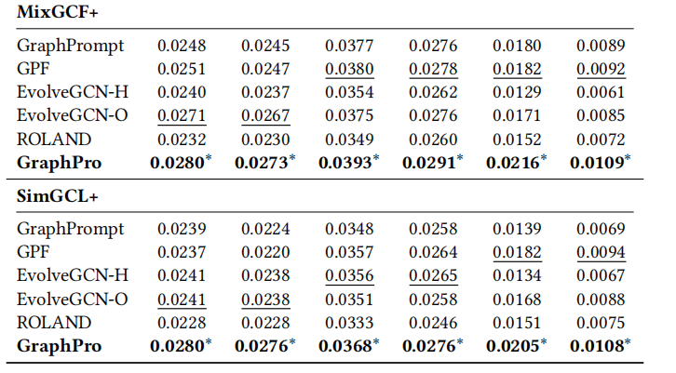
ATAI
AdvancedTechniqueof
Artificial Intelligence
ATAI
ChongqingUniversity _{AdvancedTechniqueof}
of Technology Artificial Intelligence
ChongqingUniversity of Technology
Experiments

Slide 9
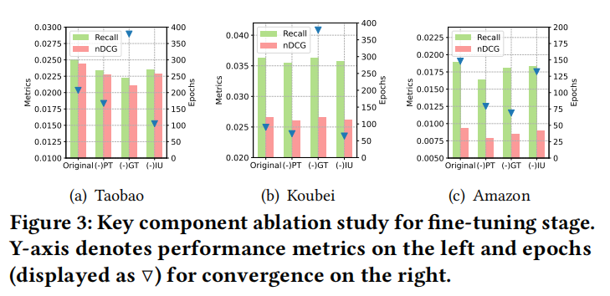
ATAI
AdvancedTechniqueof
Artificial Intelligence
ATAI
ChongqingUniversity _{AdvancedTechniqueof}
of Technology Artificial Intelligence
ChongqingUniversity of Technology
Experiments

Slide 10
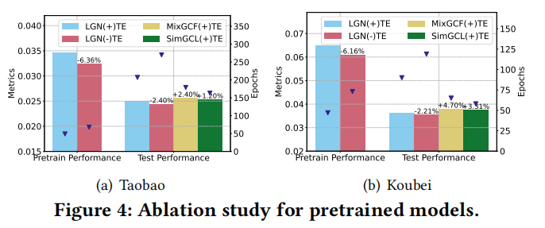
ATAI
AdvancedTechniqueof
Artificial Intelligence
ATAI
ChongqingUniversity _{AdvancedTechniqueof}
of Technology Artificial Intelligence
ChongqingUniversity of Technology
Experiments

Slide 11
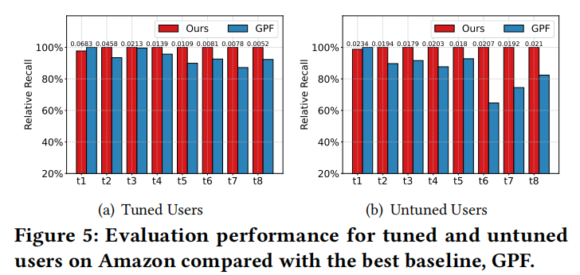
ATAI
AdvancedTechniqueof
Artificial Intelligence
ATAI
ChongqingUniversity _{AdvancedTechniqueof}
of Technology Artificial Intelligence
ChongqingUniversity of Technology
Experiments

Slide 12
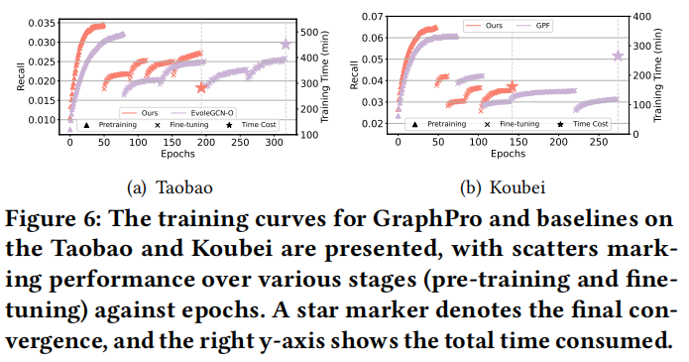
ATAI
AdvancedTechniqueof
Artificial Intelligence
ATAI
ChongqingUniversity _{AdvancedTechniqueof}
of Technology Artificial Intelligence
ChongqingUniversity of Technology
Experiments

Slide 13
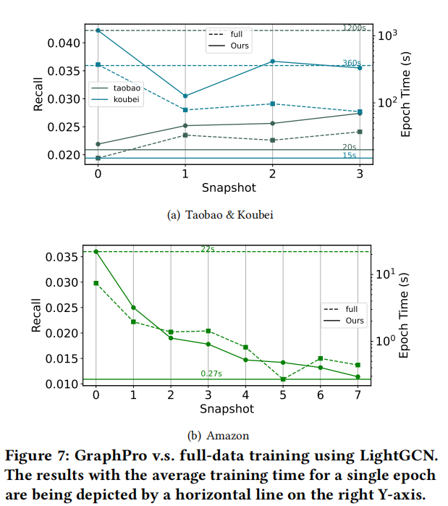
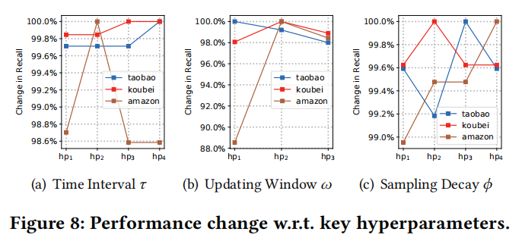
ATAI
AdvancedTechniqueof
Artificial Intelligence
ATAI
ChongqingUniversity _{AdvancedTechniqueof}
of Technology Artificial Intelligence
ChongqingUniversity of Technology
Experiments

Slide 14
ChongqingUniversity of Technology
ATAI
AdvancedTechniqueof
Artificial Intelligence
ATAI
ChongqingUniversity _{AdvancedTechniqueof}
of Technology Artificial Intelligence
Thanks!

